Slide 1
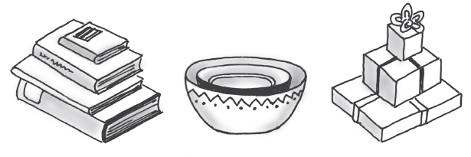
Chapter 5-6: Stacks, Stack Implementation
Manar Mohamed
mohamem@miamioh.edu

Slide 2
Midterm exam logistics:
Next Thursday (October 11), lecture time
paper exam
no computers, no calculators, no notes

Slide 3
Midterm exam: content
Everything we have done up to today’s lecture
All covered content is fair game
Heaviest focus on the things we have done the most
Content:
Chapters 1 through 6
ADTs: Bag, Set, Stack
Implementations: array-based (fixed, resizable) and link-based, working with interfaces, generics
Big Oh
Infix, postfix expressions

Slide 4
Midterm exam: content
Format (not a legally binding list):
Some short answer (such as quiz-type questions)
Reading code (what's the output? what's the error? what's Big Oh?)
Writing code (implement this method, modify that method, and so on)
How to study:
Notes (yours and mine)
Write code from scratch (you should be comfortable implementing any ADT using linked nodes or a fixed array or a resizable array)
Solve LeetCode problems
Try the self-check questions throughout each chapter. Answers appear at the end of the chapters
Review the essential features of each ADT we have studied

Slide 5
Reminders for next week
Next week:
Thursday, OCT 11: Midterm exam
Sunday, OCT. 14: program4 due

Slide 6
Stacks are:
First-in-first-out (FIFO)
Last-in-first-out (LIFO)
Once-in-never-out (OINO)
Delicious-with-syrup (DWS)

Slide 7
Which operation puts an element on the top of the stack?
peek
pop
push
pull
puree
none of these

Slide 8
Which operation puts an element on the bottom of the stack?
peek
pop
push
pull
puree
none of these

Slide 9
In a stack, you can only access the top element

Slide 10
Which operation removes the top element of the stack?
peek
pop
push
pull
puree
none of these

Slide 11
Which operation looks at the top element of the stack?
peek
pop
push
pull
puree
none of these

Slide 12
What should happen if you attempt to peek or pop an empty stack?
return 0
return the string "empty"
return null
throw an EmptyStackException

Slide 13
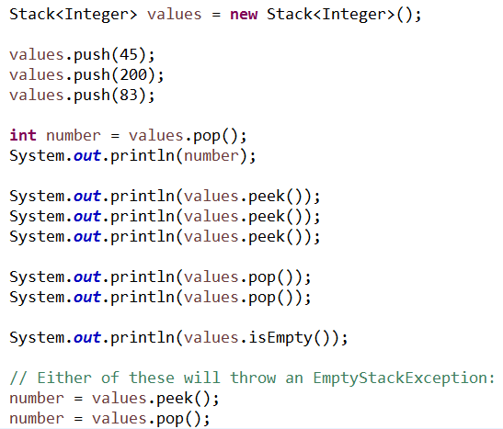
Example of a Stack in use:

Slide 14
Consider the following code. What is the value of sum? Stack<Integer> s = new Stack<>(); s.push(5); s.push(10); s.push(13); int sum = s.pop() + s.peek() + s.pop();
20
23
28
33
36

Slide 15
The Stack ADT
A "last-in-first-out" (LIFO) data type
All additions and removals happen at the top of the stack
Adding pushes things down. Newest item is always on top.
Expected operations:
push(T) - pushes an item onto the top of the stack
pop() - pops the top item off the stack
peek() - looks at the top item without popping it
isEmpty() - tells if the stack is empty
clear() - removes all items

Slide 16
Specifications of the ADT Stack
Data
A collection of objects in reverse chronological order and having the same data type
Pseudocode | UML | Description
push(newEntry) | +push(newEntry: T): void | Task: Adds a new entry to the top of the stack. Input: newEntry is the new entry. Output: None.
pop() | +pop(): T | Task: Removes and returns the stack’s top entry. Input: None. Output: Returns the stack’s top entry. Throws an exception if the stack is empty before the operation.
peek() | +peek(): T | Task: Retrieves the stack’s top entry without changing the stack in any way. Input: None. Output: Returns the stack’s top entry. Throws an exception if the stack is empty.
isEmpty() | +isEmpty(): boolean | Task: Detects whether the stack is empty. Input: None. Output: Returns true if the stack is empty.
clear() | +clear(): void | Task: Removes all entries from the stack. Input: None. Output: None.

Slide 17
Design Decision
When stack is empty
What to do with pop and peek?
Possible actions
Assume that the ADT is not empty;
Return null.
Throw an exception (which type?).

Slide 18
Interface for the ADT Stack

Slide 19
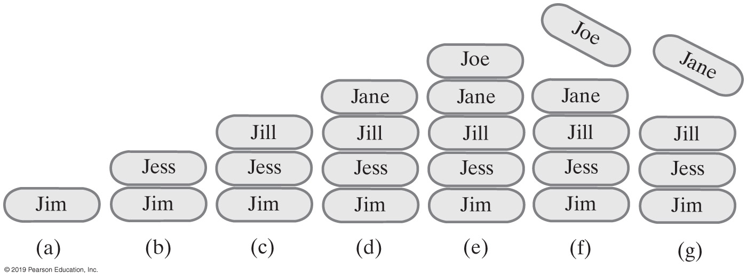
Example of a Stack
StackInterface<String> stringStack = new OurStack<>();
(a) stringStack.push(“Jim”);
(b) stringStack.push("Jess");
(c) stringStack.push("Jill");
(d) stringStack.push("Jane");
(e) stringStack.push("Joe");
(f) stringStack.pop();
(g) stringStack.pop();
FIGURE 5-2 A stack of strings
Notes:
FIGURE 5-2
A stack of strings after (a) push adds Jim; (b) push adds Jess; (c) push adds Jill; (d) push adds Jane; (e) push adds Joe; (f ) pop retrieves and removes Joe; (g) pop retrieves and removes Jane

Slide 20
Uses of a stack:
Program stack keeps track of which methods are still in progress
"stack overflow" means too many unresolved method calls are in progress
Determining whether parentheses are balanced in a mathematical expression. For example:
Balanced: (3 + 7 * (8 + 4)) * (2 + 5)
Not balanced: (4 + 5) * (6 + 7 * 8 + (4 * 3)
See a more advanced problem here: https://www.careercup.com/question?id=5067220493271040
Evaluating mathematical expressions. For example:
(3 + 7 * (8 + 4)) * (2 + 5)

Slide 21
Agenda:
Stack implementations
Determining whether parentheses are balanced in a mathematical expression
Infix and postfix expressions

Slide 22
Stack implementations:
Link-based:
easiest to access the head node, so that's where we push, pop, peek
push, pop, peek, isEmpty, clear are O(1) operations
Array-based (what you'll do for homework):
easiest to access the end of the array, so that'w where we push, pop, peek
resize the array if more room is needed: create new array twice the size, copy values to new array
pop, peek, isEmpty, clear are O(1) operations
but what about push?

Slide 23
push() and resizing the array
Resizing the array is O(n)
BUT...we don't have to resize every time.
For example, if the array is size 500, and it's full, and we push one more value:
We need to resize the array, BUT…
We won't need to resize for the next 500 pushes
Resizing is O(n), but that cost is "spread out" (amortized) over the next 500 pushes.
So, push is still roughly O(1)

Slide 24
Link-based Stack Implementation

Slide 25
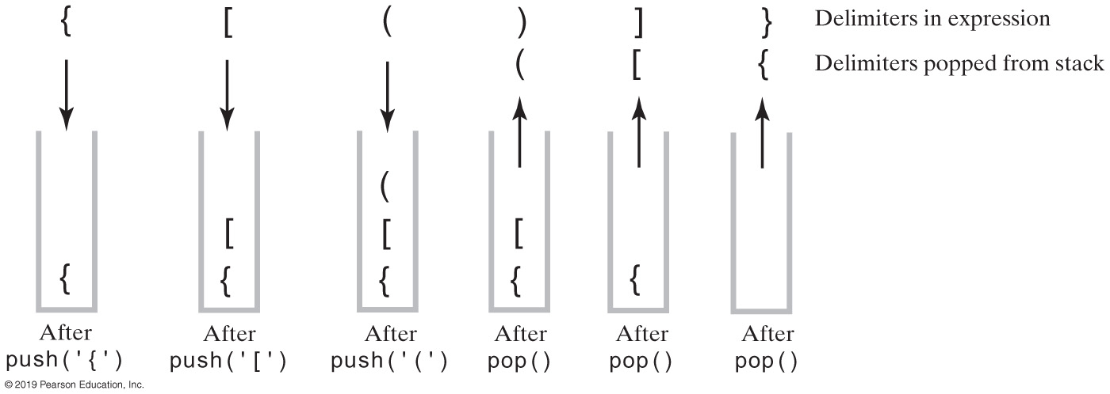
Processing Algebraic Expressions
FIGURE 5-3 The contents of a stack during the scan of an expression that contains the balanced delimiters{ [ ( ) ] }

Slide 26
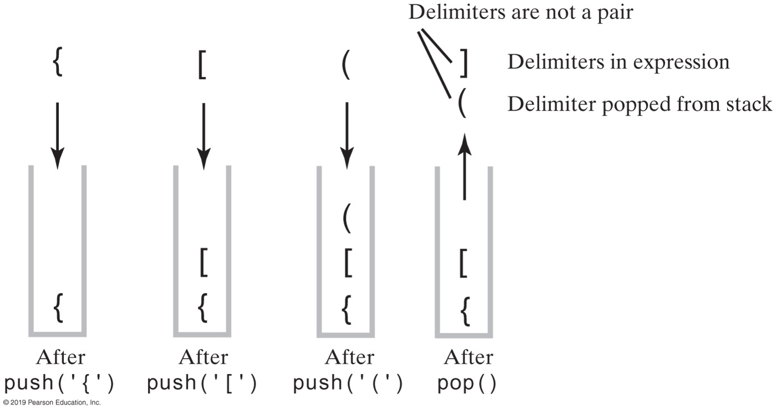
Processing Algebraic Expressions
FIGURE 5-4 The contents of a stack during the scan of an expression that contains the unbalanced delimiters { [ ( ] ) }

Slide 27
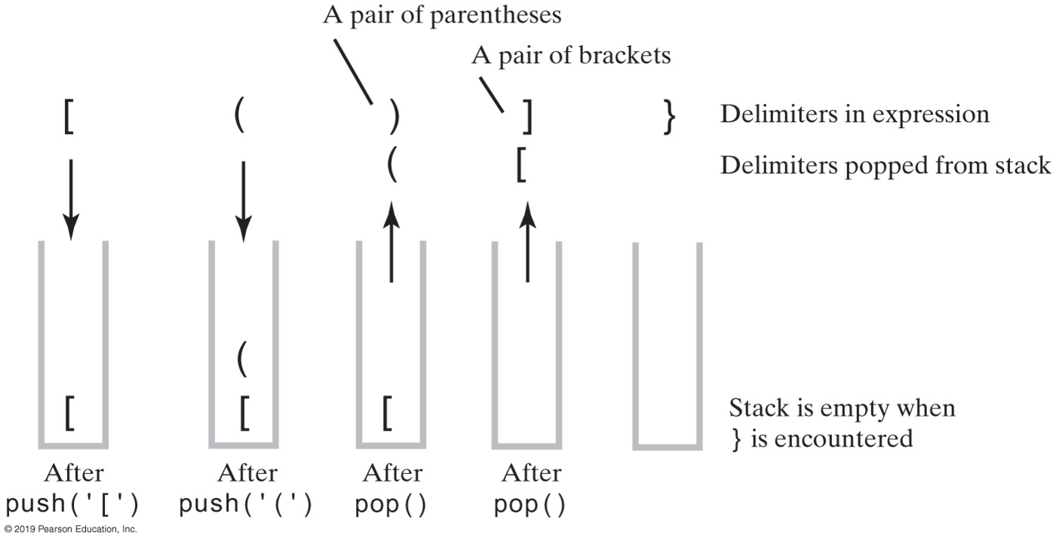
Processing Algebraic Expressions
FIGURE 5-5 The contents of a stack during the scan of an expression that contains the unbalanced delimiters [ ( ) ] }

Slide 28
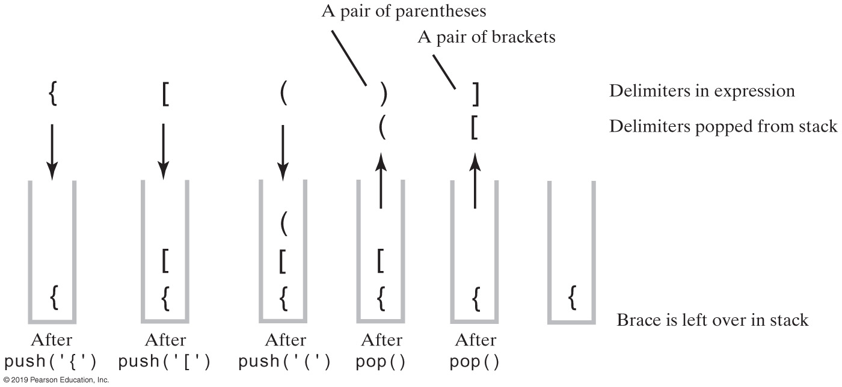
Processing Algebraic Expressions
FIGURE 5-6 The contents of a stack during the scan of an expression that contains the unbalanced delimiters { [ ( ) ]

Slide 29
Processing Algebraic Expressions Code

Slide 30
Infix and Postfix expressions
Evaluate each of these infix expressions…
3 + 4 * 5
(3 + 4) * 5
10 ^ 3
2 ^ 2 ^ 3
15 % 4 - 2 + 13
3 + 4 * (10 / 2 - 3) + 6
Notes:
23
35
1000
256
14
17

Slide 31
Notice how these are evaluated differently:
2 ^ 2 ^ 3 means 2 ^ (2 ^ 3)
2 - 2 - 3 means (2 - 2) - 3

Slide 32
Operator precedence, from highest to lowest:
Expressions in parentheses
^
* / % (equal precedence)
+ - (equal precedence)

Slide 33
When we evaluate a complicated expression...
3 + 4 * (10 / 2 - 3) + 6
We can't just evaluate left to right.
When we see "+", we can't add until we know it's the right time.
Certain operations need to be put "on hold" so that we can come back to them later, when it's time.
In this case, what is the first calculation that will actually take place?
What is the last calculation that will take place?
How can we write a program that evaluates expressions like this?

Slide 34
One solution...a two step process:
Convert the infix expression to a postfix expression
Evaluate the postfix expression
Is this the only way? No. But it works well. And once you understand it, you can start thinking of ways to do it in one step instead of two.

Slide 35
What is a postfix expression?
The expression puts the operator (such as +) after the operands (the numbers)
Infix puts the operator between the operands.
Infix: 3 + 4
Postfix: 3 4 +

Slide 36
Converting from infix to postfix
Both expressions will have the numbers in the exact same order.
Postfix will put the operators in the order they will be evaluated.
Postfix does not have (or need) parentheses.
Example:
Infix: 3 + 4 * (10 / 2 - 3) + 6
Postfix: 3 4 10 2 / 3 - * + 6 +

Slide 37
Doing easy ones in your head:
Infix: 3 * 4 + 6
Postfix: 3 4 * 6 +

Slide 38
Doing easy ones in your head:
Infix: 6 + 3 * 4
Postfix: 6 3 4 * +

Slide 39
Wait...why are we doing this?
Postfix seems more confusing.

Slide 40
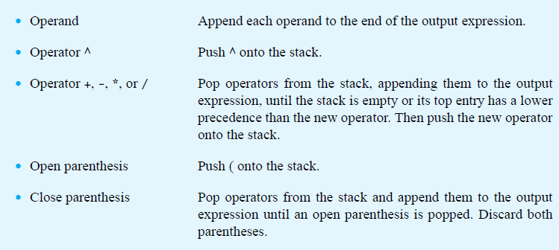
Infix-to-postfix Conversion
© 2015 Pearson Education, Inc., Upper Saddle River, NJ. All rights reserved.

Slide 41
Roughly what it means:
When you get to a number, write it down.
When you get to an operator...
...push it on the stack after popping any operators that have higher or equal precedence.
...write down the operators as you pop them from the stack.
( gets pushed.
) means pop all the way down to the (
When you reach the end of the infix, finish popping the stack.

Slide 42
Infix and Postfix expressions
Convert some of these to postfix. Keep track of the expression and the stack as you go
3 + 4 * 5
4 * 5 + 3
(3 + 4) * 5
10 ^ 3
2 ^ 2 ^ 3
15 % 4 - 2 + 13
3 + 4 * (10 / 2 - 3) + 6

Slide 43
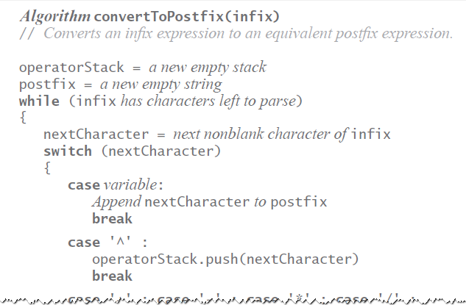
Infix-to-postfix Algorithm
© 2015 Pearson Education, Inc., Upper Saddle River, NJ. All rights reserved.

Slide 44
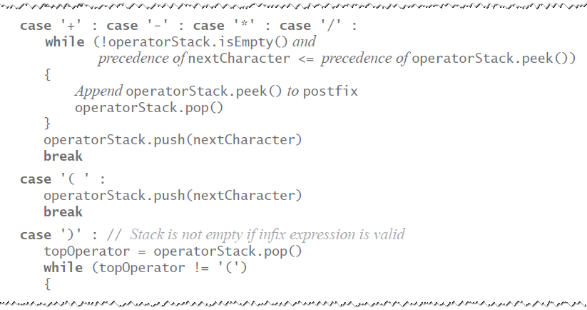
Infix-to-postfix Algorithm
© 2015 Pearson Education, Inc., Upper Saddle River, NJ. All rights reserved.

Slide 45
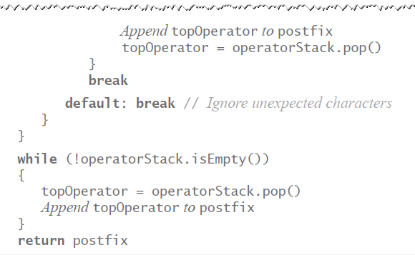
Infix-to-postfix Algorithm
© 2015 Pearson Education, Inc., Upper Saddle River, NJ. All rights reserved.

Slide 46
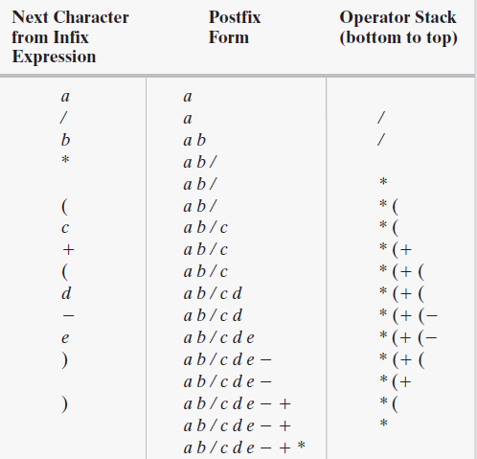
Infix to Postfix
FIGURE 5-9 The steps in converting the infix expression a / b * (c + (d - e)) to postfix form
© 2015 Pearson Education, Inc., Upper Saddle River, NJ. All rights reserved.

Slide 47
Once it is in postfix form, evaluation is easy:
Evaluate left to right
Push numbers onto the stack
When you reach an operator…
Pop off the top two numbers
Evaluate
Push the result back on the stack
When we reach the end of the expression, there is one number on the stack: the correct answer.

Slide 48
Evaluating postfix expressions
Keep track of the stack as you go:
3 4 5 * +
4 5 * 3 +
2 2 3 ^ ^
15 4 % 2 - 13 +
3 4 10 2 / 3 - * + 6 +

Slide 49
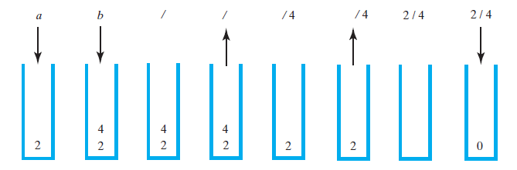
Evaluating Postfix Expressions
FIGURE 5-10 The stack during the evaluation of the postfix expression a b / when a is 2 and b is 4
© 2015 Pearson Education, Inc., Upper Saddle River, NJ. All rights reserved.

Slide 50
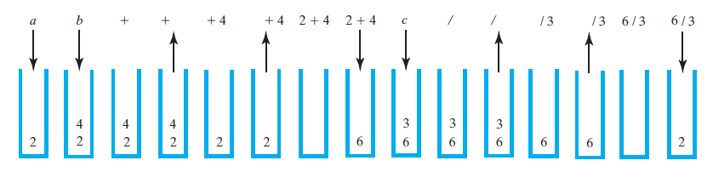
Evaluating Postfix Expressions
FIGURE 5-11 The stack during the evaluation of the postfix expression a b + c / when a is 2, b is 4, and c is 3
© 2015 Pearson Education, Inc., Upper Saddle River, NJ. All rights reserved.

Slide 51
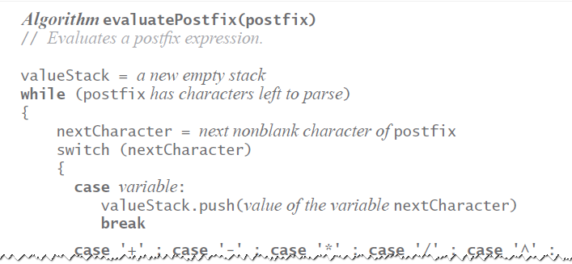
Evaluating Postfix Expressions
Algorithm for evaluating postfix expressions.
© 2015 Pearson Education, Inc., Upper Saddle River, NJ. All rights reserved.

Slide 52
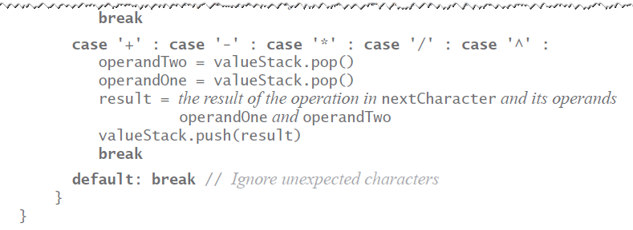
Evaluating Postfix Expressions
Algorithm for evaluating postfix expressions.
© 2015 Pearson Education, Inc., Upper Saddle River, NJ. All rights reserved.

Slide 53
END

